Slide 1

HR Attrition Analytics
A data-driven approach to understanding why employees leave and how to improve retention through actionable insights.
Prepared by -
Harshit Verma

Slide 2







Project Overview
Goal
Approach
Understand why employees leave and identify key risk factors for attrition
Structured data-driven analysis covering demographics, satisfaction, and compensation
Output
Multi-page Power BI dashboard designed for HR decision-makers
The analysis examines demographic factors, satisfaction levels, work-life balance, tenure patterns, salary structures, and job experience to provide HR teams with comprehensive insights for improving employee retention strategies.

Slide 3
Dataset & Technology Stack
IBM HR Attrition Dataset
Tools Used
Employee-level information including:
Python
Demographics (Age, MaritalStatus)
Job details (Department, YearsAtCompany)
Pandas, NumPy, Matplotlib, Seaborn for EDA
Satisfaction scores (JobSatisfaction, EnvironmentSatisfaction, WorkLifeBalance)
SQL
Compensation (MonthlyIncome)
Experience (NumCompaniesWorked, Education)
Deep workforce insights and pattern validation
Attrition status
Power BI
Interactive dashboard visualization

Slide 4
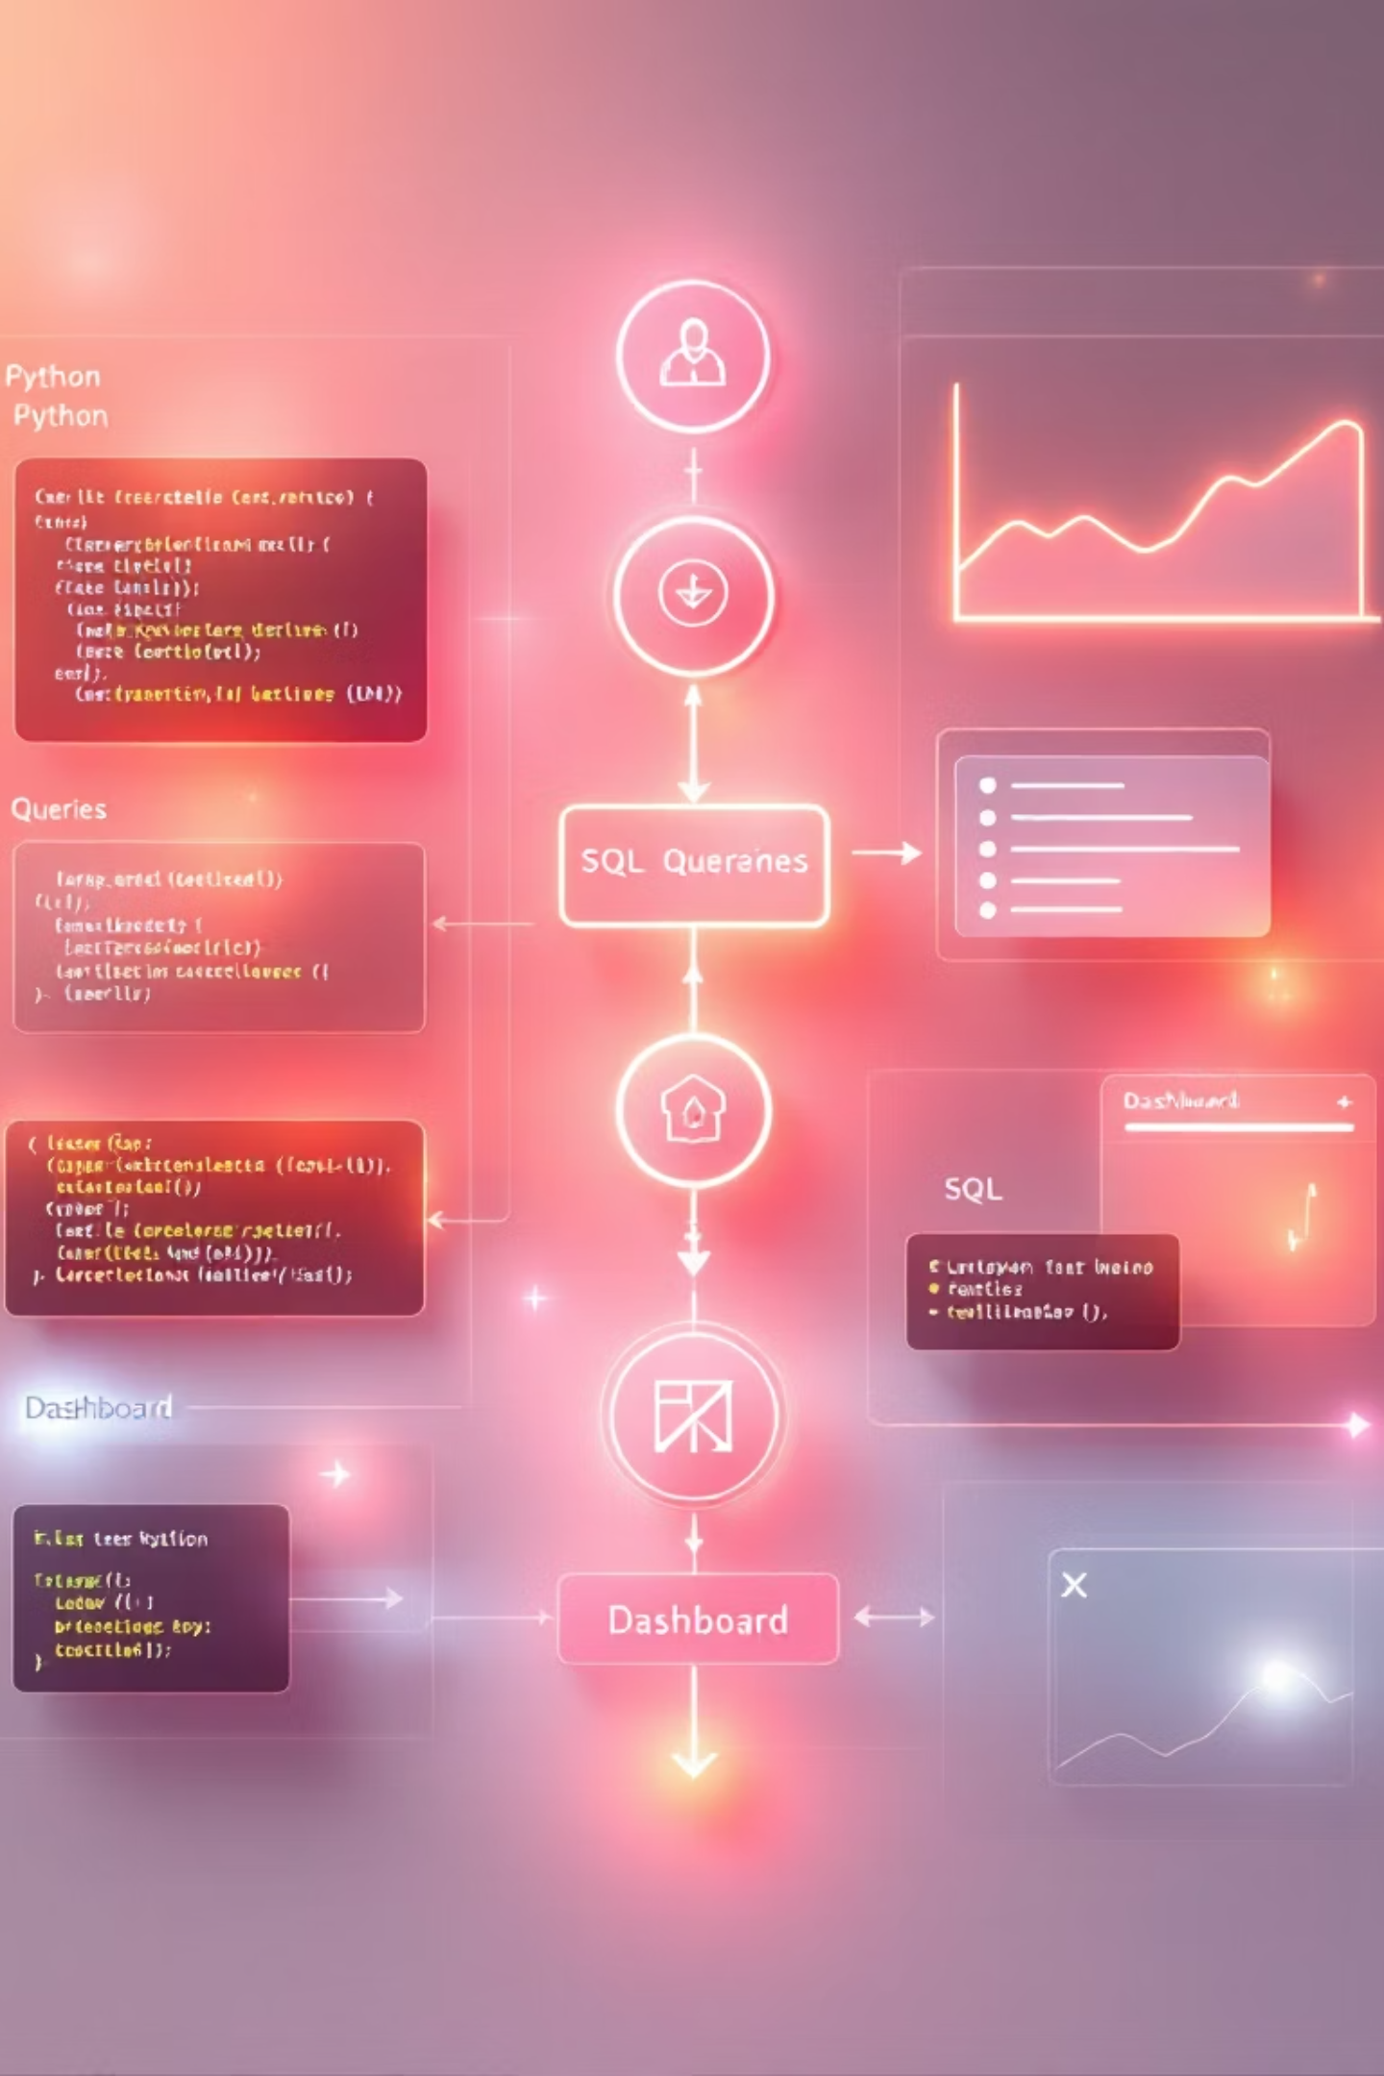



Methodology: Three-Phase Analysis
Python EDA
Feature engineering and exploratory data analysis to identify patterns
SQL Queries
Compute deeper workforce insights and validate EDA patterns
Power BI Dashboard
Three-page interactive visualization for HR decision-makers
This end-to-end analytics workflow combines exploratory analysis, database querying, and interactive visualization to deliver comprehensive insights into employee attrition patterns and risk factors.

Slide 5
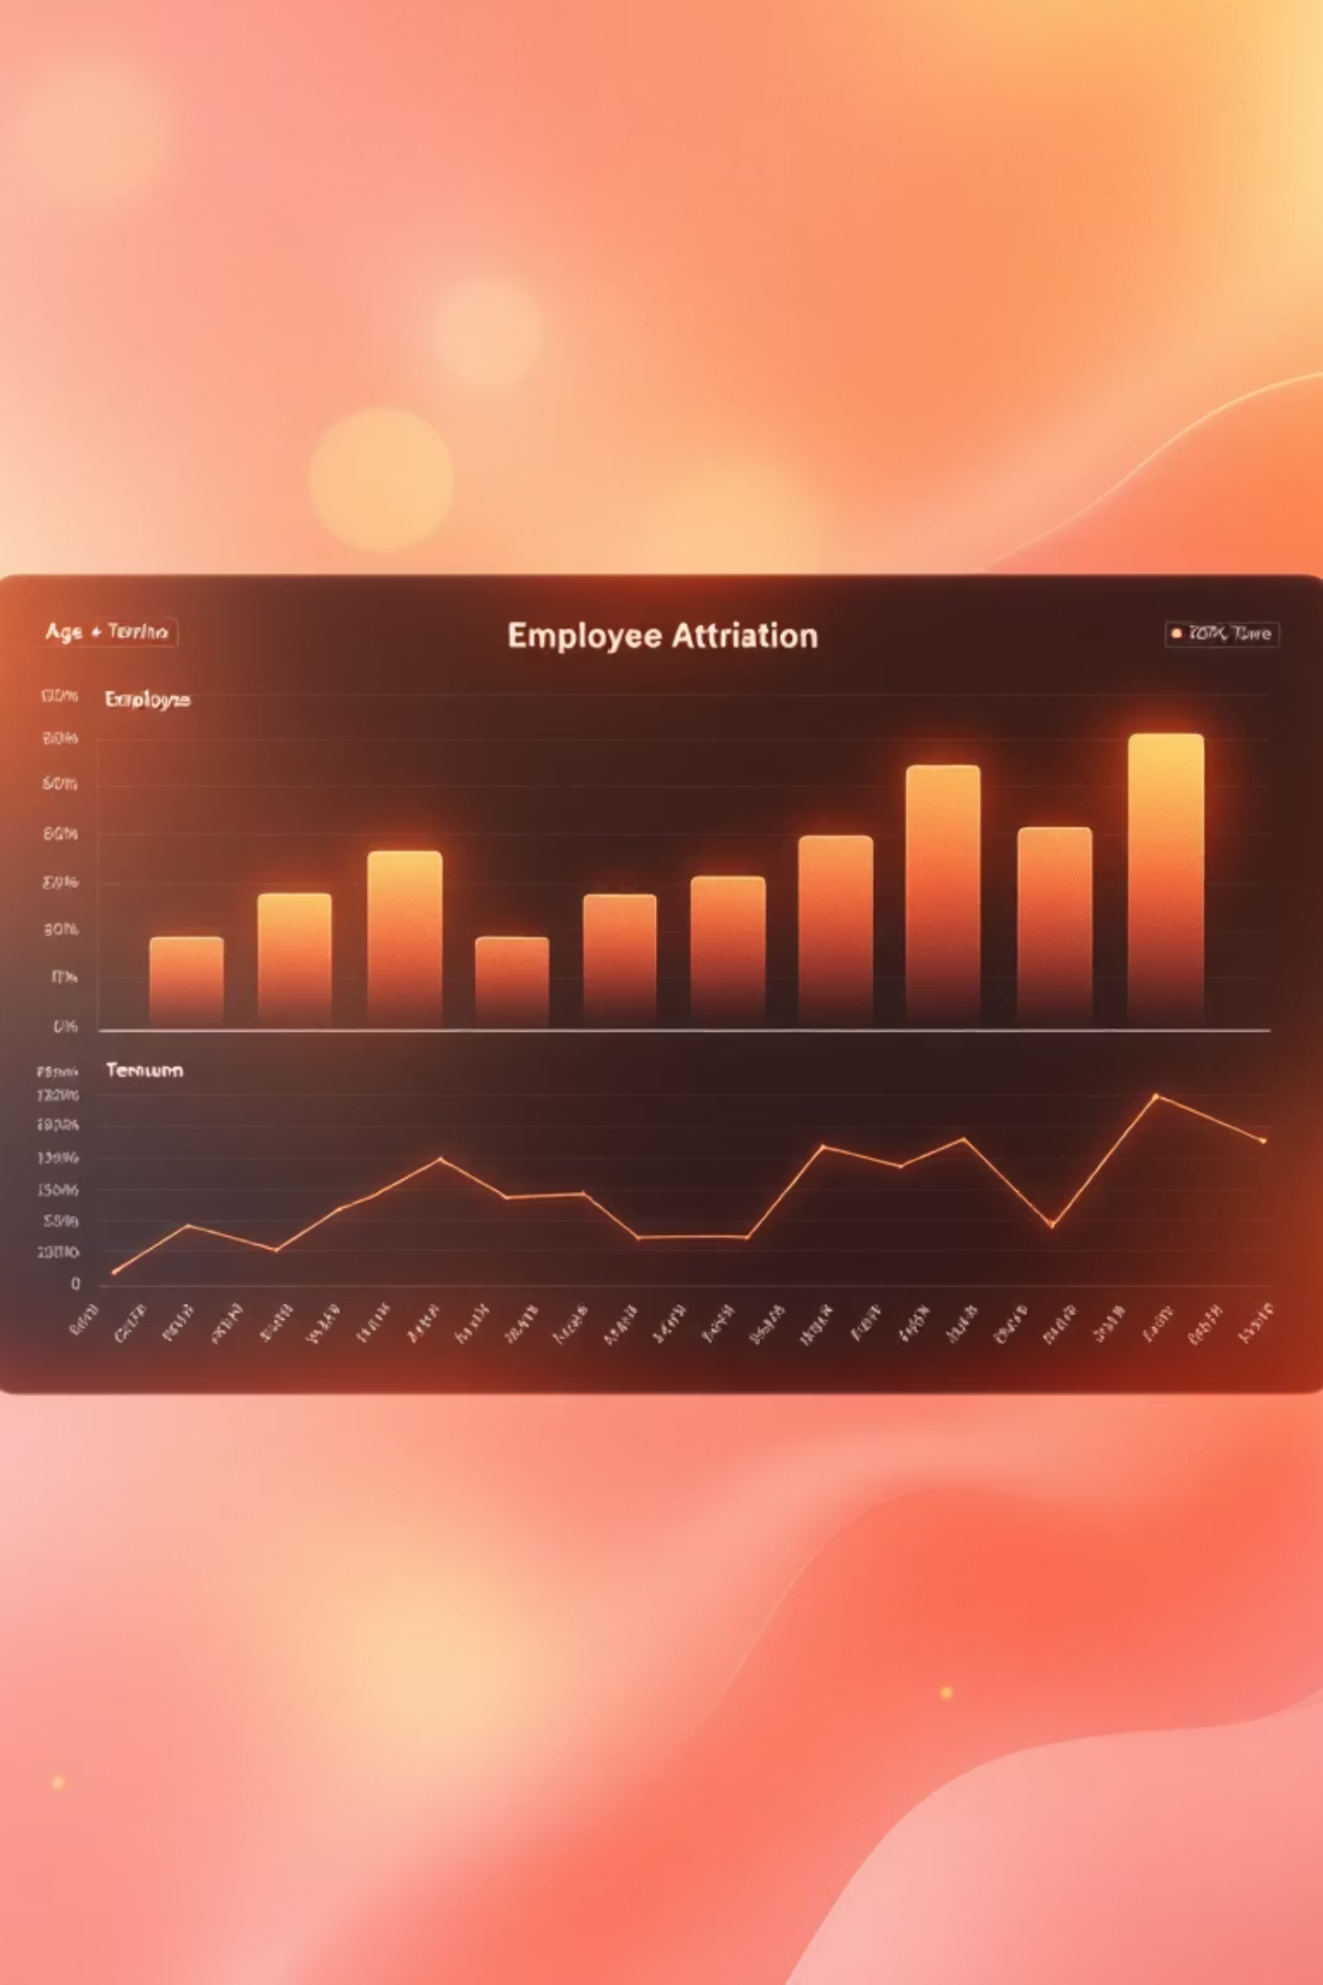
Python EDA: Key Findings
16.12%
26-35
2-3
Attrition Rate
Highest Risk Age
Critical Years
Overall employee turnover across the organization
Majority of attrition in this age group
Early tenure shows highest attrition risk
Feature engineering created AgeGroup, IncomeBand, TenureGroup, SatisfactionScore, and AttritionFlag variables. Analysis revealed that employees with lower salary and satisfaction scores showed significantly higher churn rates. Departmental patterns indicated elevated attrition in Sales and Research & Development divisions.

Slide 6

Dashboard Page 1: HR Summary
Key Metrics
Critical Insights
Married employees show lower attrition compared to
single employees
Sales and R&D departments have highest attrition counts
Life Science and Medical fields show elevated turnover
237
Satisfaction metrics consistently lower among departing
employees
16.12%
Attrition Rate
Total Attrition
Total Employees: 1,470
Average Income: $6.5K monthly
Average Tenure: 7 years
The dashboard visualizes attrition by marital status, department, education field, and satisfaction levels (job, environment,
work-life balance), providing a comprehensive overview of workforce dynamics.

Slide 7

Dashboard Page 2: Compensation & Experience
Income Distribution
Tenure vs Salary
Majority of employees fall in Low and Very Low income brackets, with these bands showing significantly higher attrition rates
Employees with 0–3 years tenure and low income are the most vulnerable to attrition
Job History Pattern
Individuals who worked at more companies previously tend to leave more frequently
Key visualizations include monthly income distribution, attrition by income band, salary vs tenure scatter plots, and the relationship between number of companies worked and attrition rates, alongside work-life balance analysis.

Slide 8


Dashboard Page 3: Satisfaction & Risk Segments
High-Risk Indicators
Low Satisfaction
2.74
Attrition highest among employees with satisfaction level 1 or 2
Age & Department
Average Satisfaction
Younger employees in R&D show highest attrition cluster
Short Tenure
0–3 year employees contribute almost half of total attrition
This page features satisfaction gauges, attrition by age group and department matrix, tenure group analysis, and a high-risk employee table identifying individuals with combined risk factors.

Slide 9




Key Insights & Recommendations
Improve Compensation
Early-Tenure Engagement
Introduce competitive pay for entry-level roles and benchmark salary ranges with industry standards. Low and Very Low income bands show significantly higher attrition.
Build stronger onboarding and mentorship programs with regular check-ins within the first year. Provide clear career path guidance early in employment.
Boost Satisfaction
Targeted Retention
Invest in leadership training and job enrichment. Conduct satisfaction surveys, respond to feedback, and reduce workload stress to improve work-life balance.
Focus on Sales and R&D with tailored initiatives: skill development opportunities, performance incentives, and flexible work policies.

Slide 10





Conclusion: Building a Stable Workforce
This HR Attrition Analytics project delivers a comprehensive understanding of workforce dynamics through Python EDA, SQL analysis, and an interactive Power BI dashboard. The data-backed approach reveals critical factors driving employee turnover.
Competitive Pay
Meaningful Work Environment
Early-Career Support
Department-Specific Strategies
By implementing a high-risk employee monitoring system and these targeted recommendations, organizations can reduce attrition, strengthen employee engagement, and build a stable, satisfied workforce for long-term success.

